Slide 1
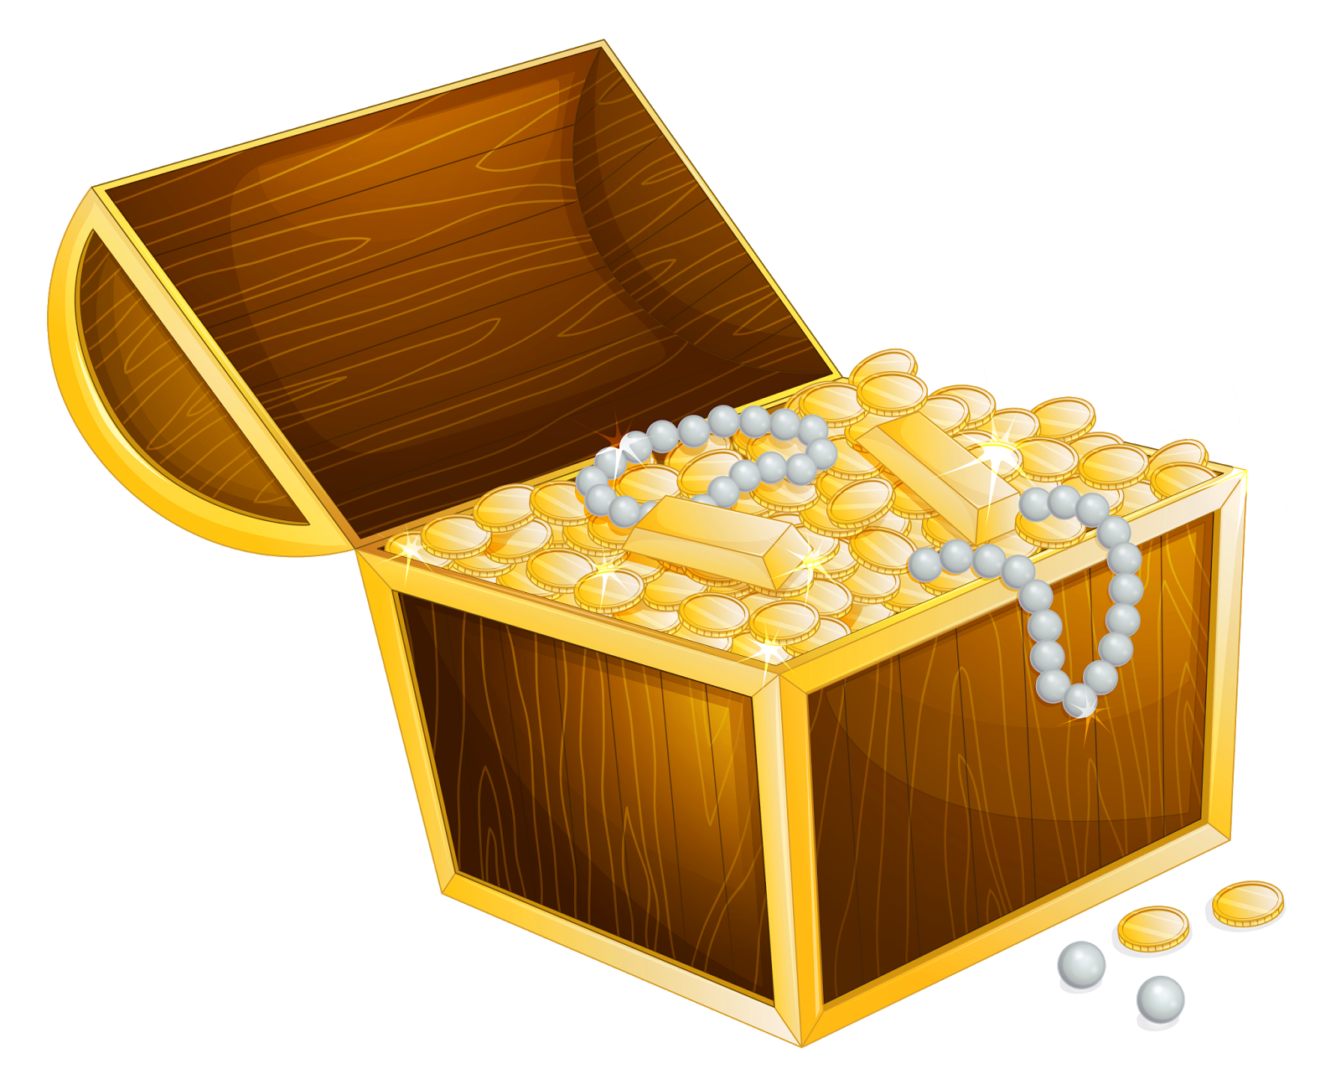
Pirate training 101
By Annie Abay and Carissa Gadson
6.S08 Spring 2016

Slide 2
Project Overview
Our final project is an interactive maze game
Players will select their kerberos and a level to play on the OLED screen
The objective is to collect a number of chests, depending on the level of the game, in the shortest possible time
Travel through the maze is dictated by steps and turns in the physical world
At the end of the game, a scoreboard will appear on the OLED with the kerberos and time of the 5 fastest players

Slide 3
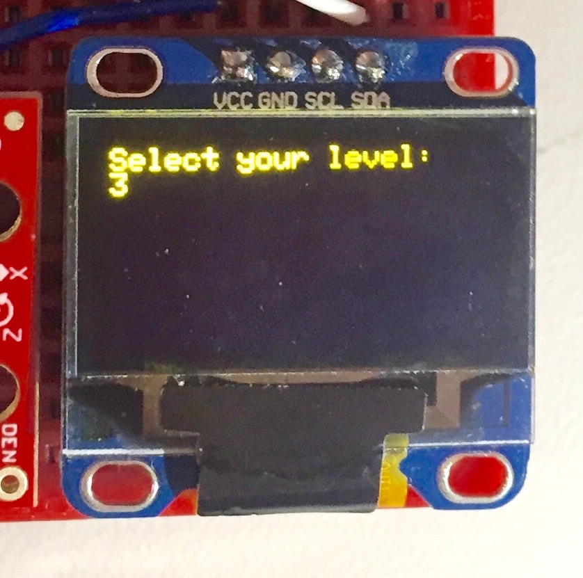
Selecting Kerberos and Level
I’m an exciting picture wheeeeee
Selecting kerberos and level work very similarly
Button on the left allows player to scroll through and select kerberos
Button on the right is the select button
Repeat for level selection

Slide 4
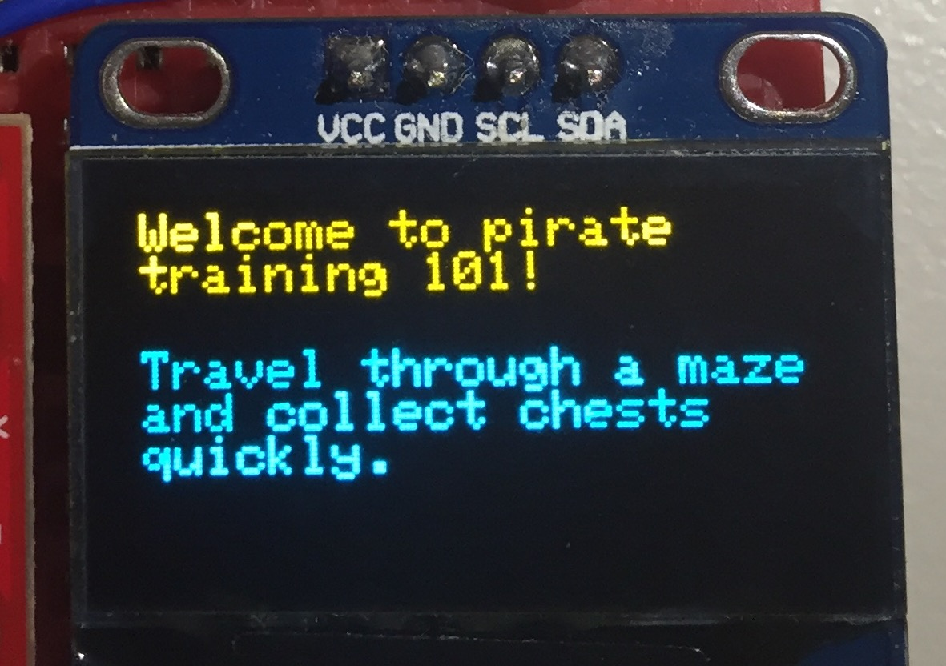
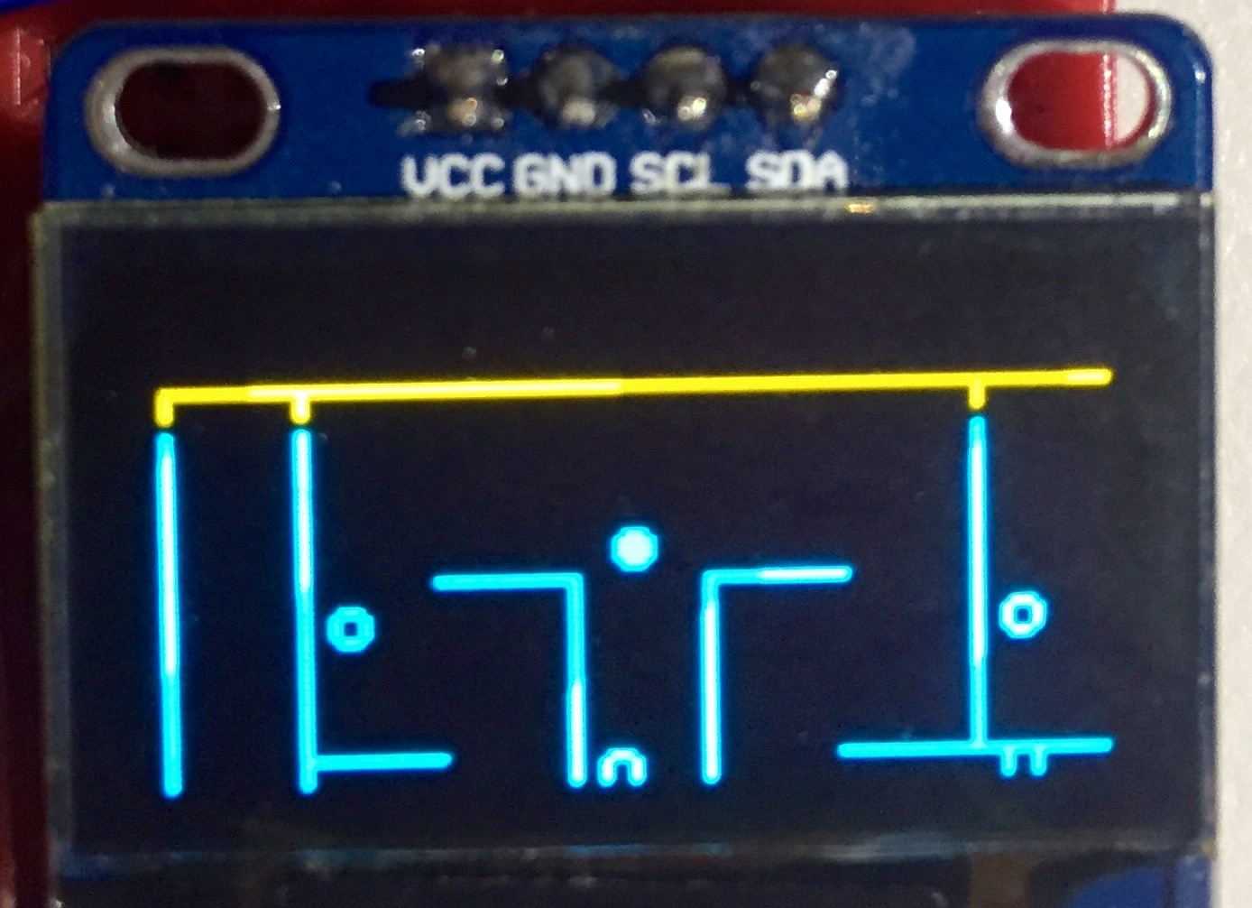
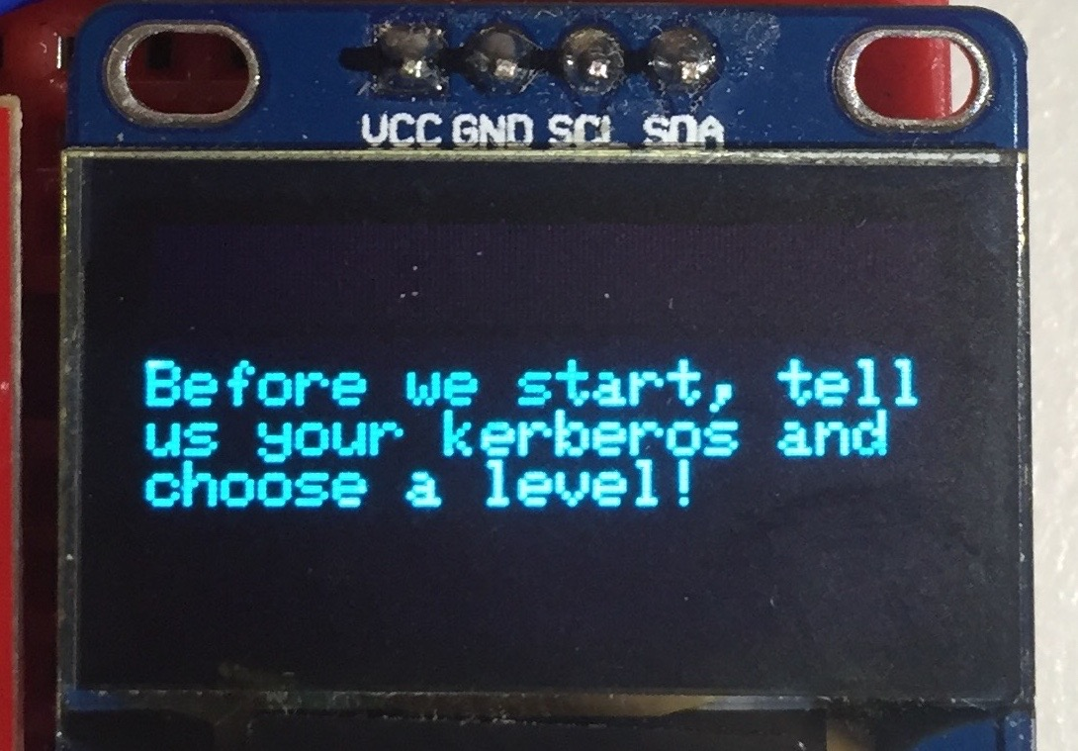
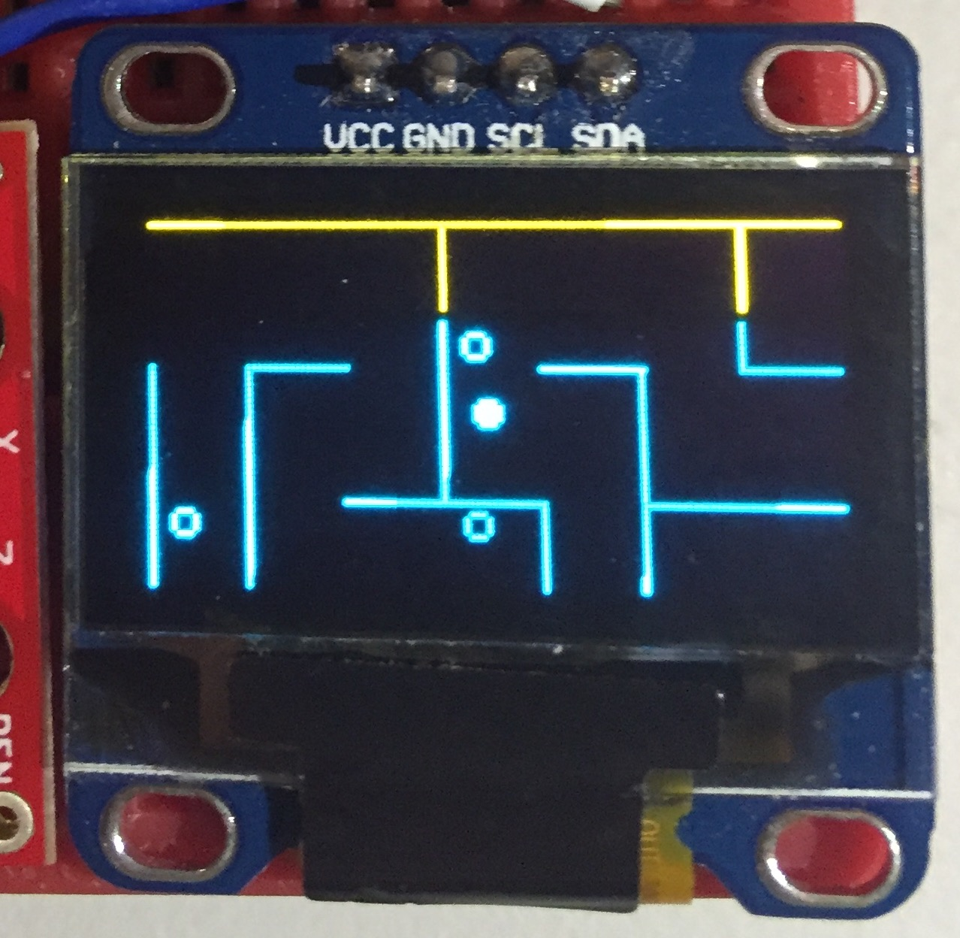
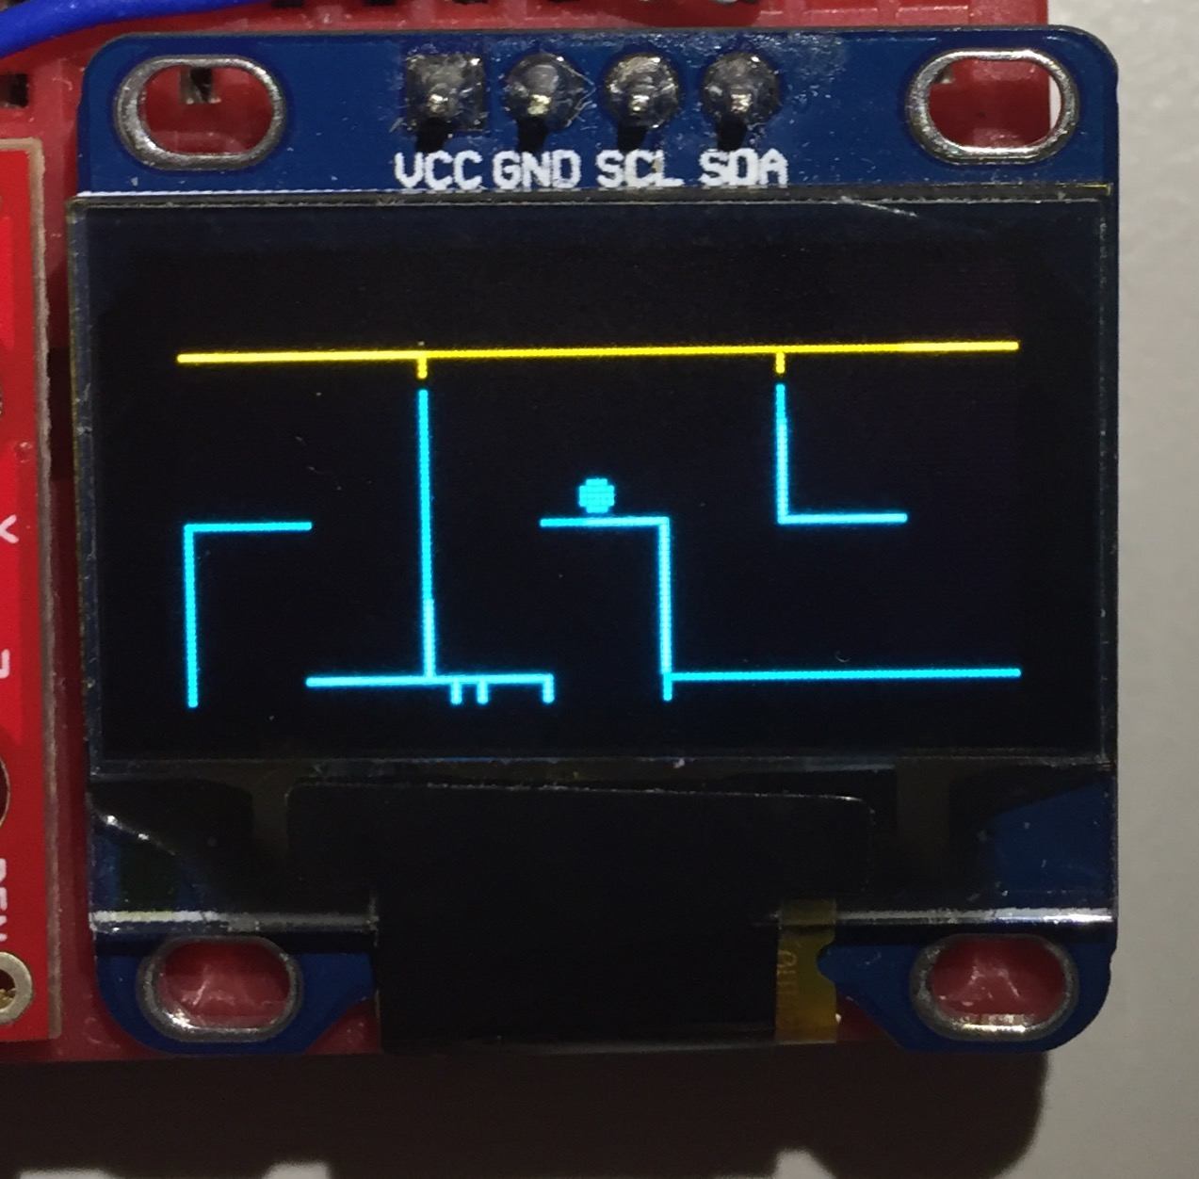
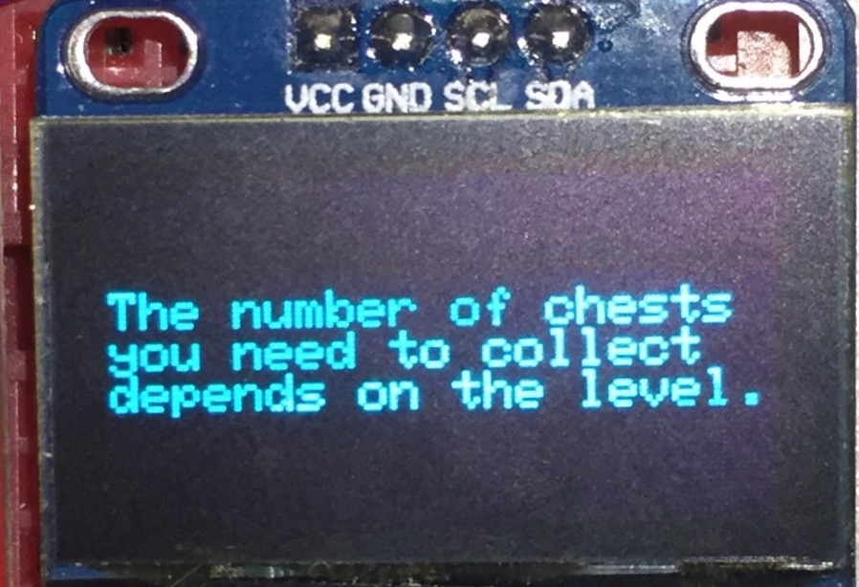

Slide 5
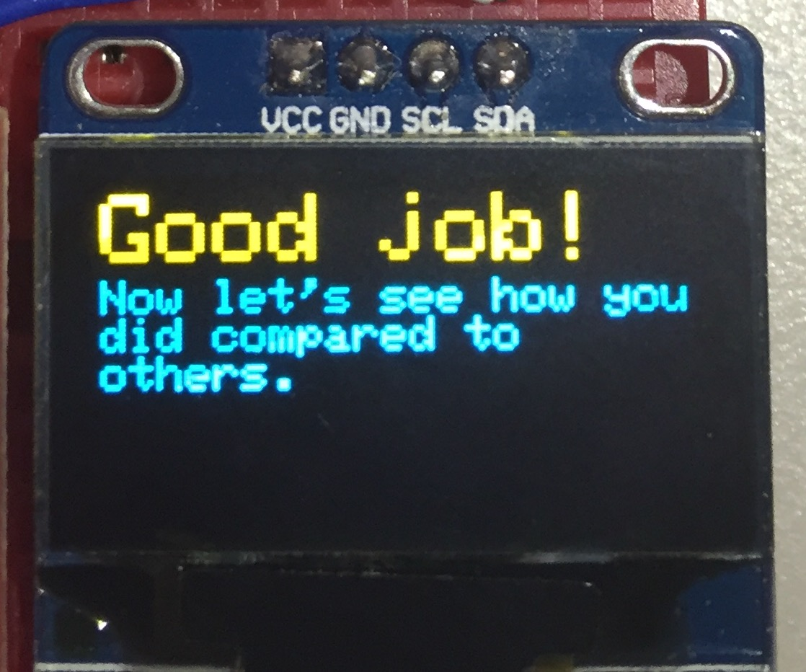
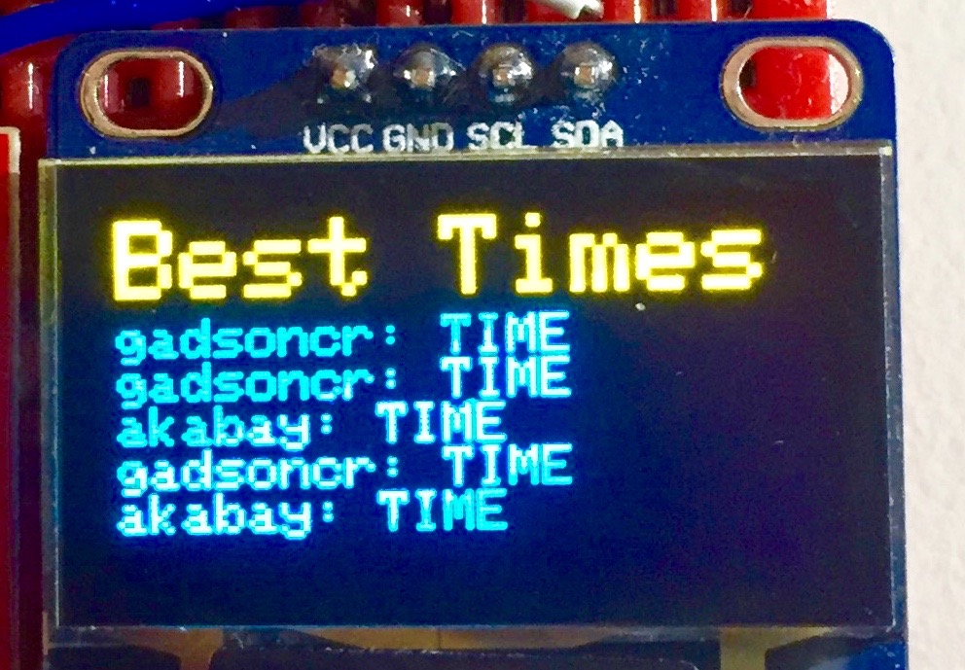

Slide 6
Game Class (in main file of mazgame)
getMaze – POST and GET requests for maze depending on chosen level
getTimes – POST and GET requests for five lowest times depending on chosen level
startGame – displays introduction to user
runGame – calls make_maze if not already created, starts and ends play time, calls functions to detect angle, number of chests, and move the maze
endGame – calls getTimes and displays lowest times
top_player_message.py
logs and retrieves maze and top five lowest times from database (in accordance with level played)
POST params: Kerberos, level, starttime, endtime, rep
GET param: level
Scoreboard Database
Kerberos
Level
Starttime
Endtime
Chests
Mazes Database
Rep (maze)
MyCompass.cpp
Includes MyCompass class that calibrates the imu, finds heading and has functions to turn heading into cardinal direction
Select.cpp
Includes KerberosSelect and LevelSelect classes that prompts and records user input of Kerberos and level
Player Class (in main file of mazegame)
didTakeStep – records when a step is taken, calls movePlayer
movePlayer – calls functions that calculate heading and check_move
check_move – checks if move is valid and checks for chest collection
updateDisplay – prints the user object
MyCompass.h
Header file that corresponds with MyCompass.cpp file
Declares class and private/public functions and variables
Select.h
Header file that corresponds with Select.cpp file
Declares class and private/public functions and variables

Slide 7
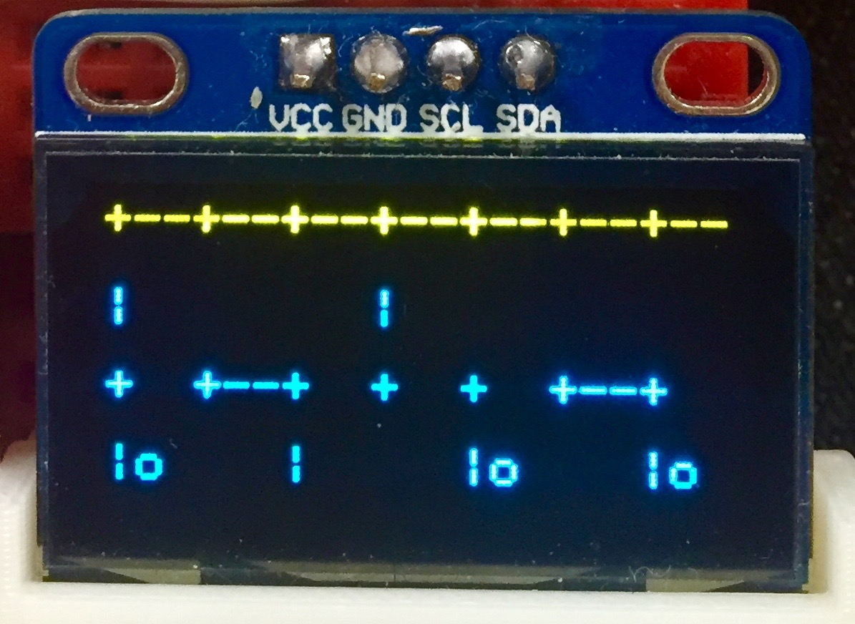
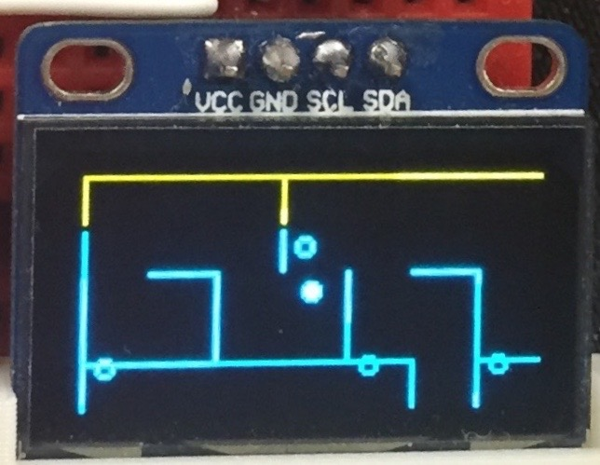
Technical Challenges
Displaying walls
Moving user object
Setting boundaries

Slide 8
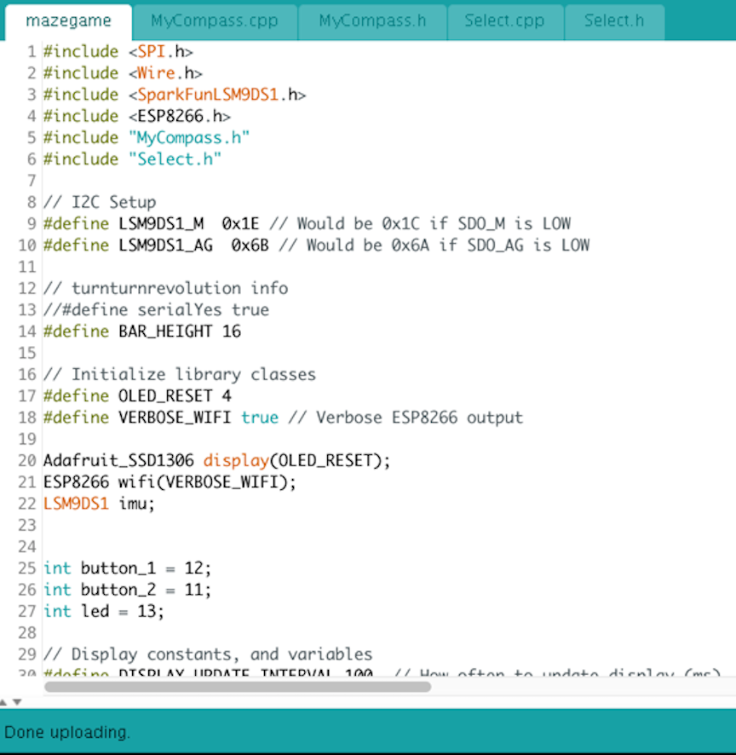
technical challenges (cont.)
Accuracy of angle detection
Making database info into maze array
Making database info into a character array as opposed to strings

Slide 9
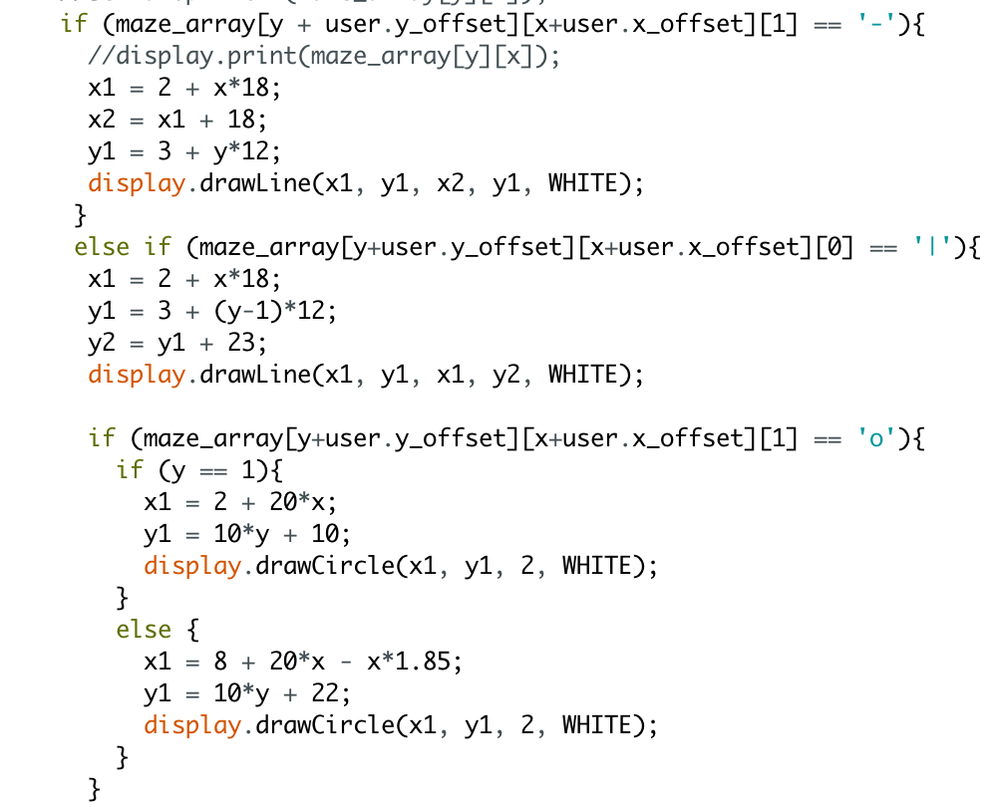
Changes made along the way
Running from start to end vs. Collecting chests
Displaying part of the maze at a time
IMU vs. buttons
Representations of maze
Storing maze in database
Size of mazes of different levels

Slide 10
What we learned
Debugging is very time-consuming
Files get large quickly; splitting it up helps!
Python can be a lot easier to work with (i.e. random maze generator)
There are many different ways to code the same thing
Makes finding the most efficient way more difficult

Slide 11
Ideas for Future Improvement
Representing maze more accurately on screen
Different maze sizes for levels
Multiplayer
GPS

